Slide 1
ZimmerZone
Skyler Davis

Slide 2
ZimmerZone
This is an app where fans of Hans Zimmer can reminisce together and comment on his albums (scores )
Each album will have its own page that contains information on, as well as a comments section for, that particular album
Users will be able to add, edit, and delete comments

Slide 3
Features Included
Sign in authentication
Comments section
Likes

Slide 4
Pain Points
Time management. There was a lot to do and that meant hitting a road block would be very dangerous. There were a number of times
I had to force myself to work on something else and come back to the road block later.
Writing proper routes.
Dealing with so many files at once.

Slide 5
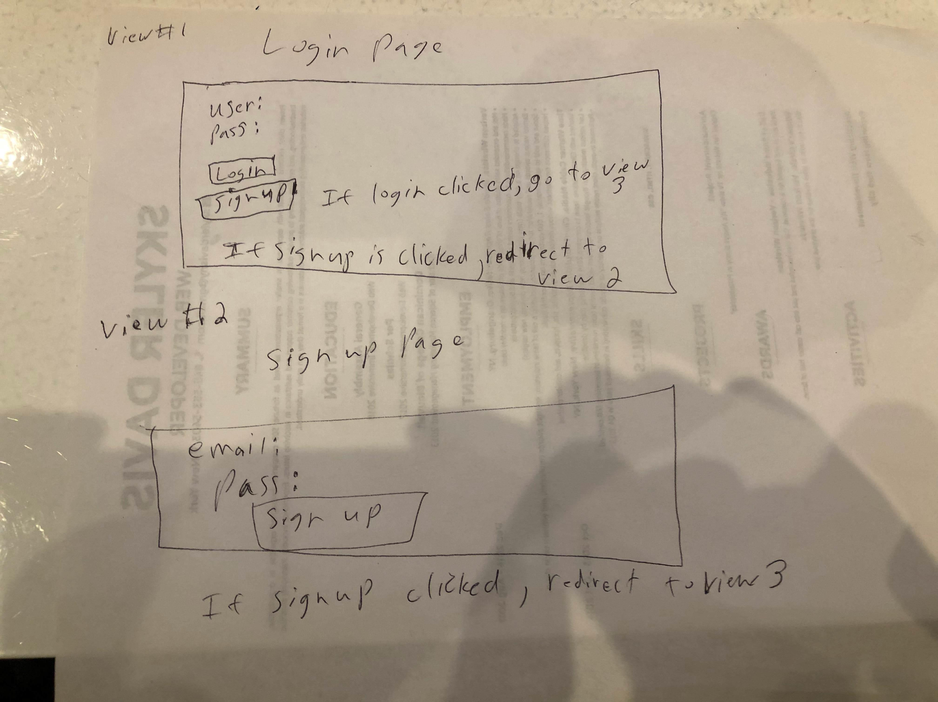
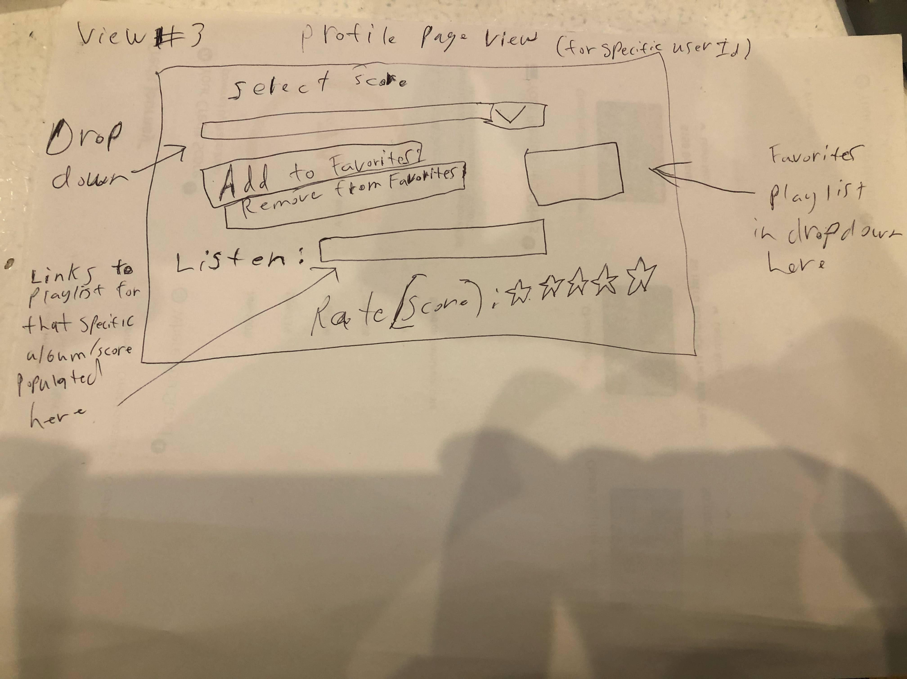
Wireframes

